Slide 1
COMP 2230
Week 8 - Friday

Slide 2
Last time
Properties of relations:
  Reflexive
  Symmetric
  Transitive
Equivalence relations

Slide 3
Questions?

Slide 4
Assignment 4

Slide 5
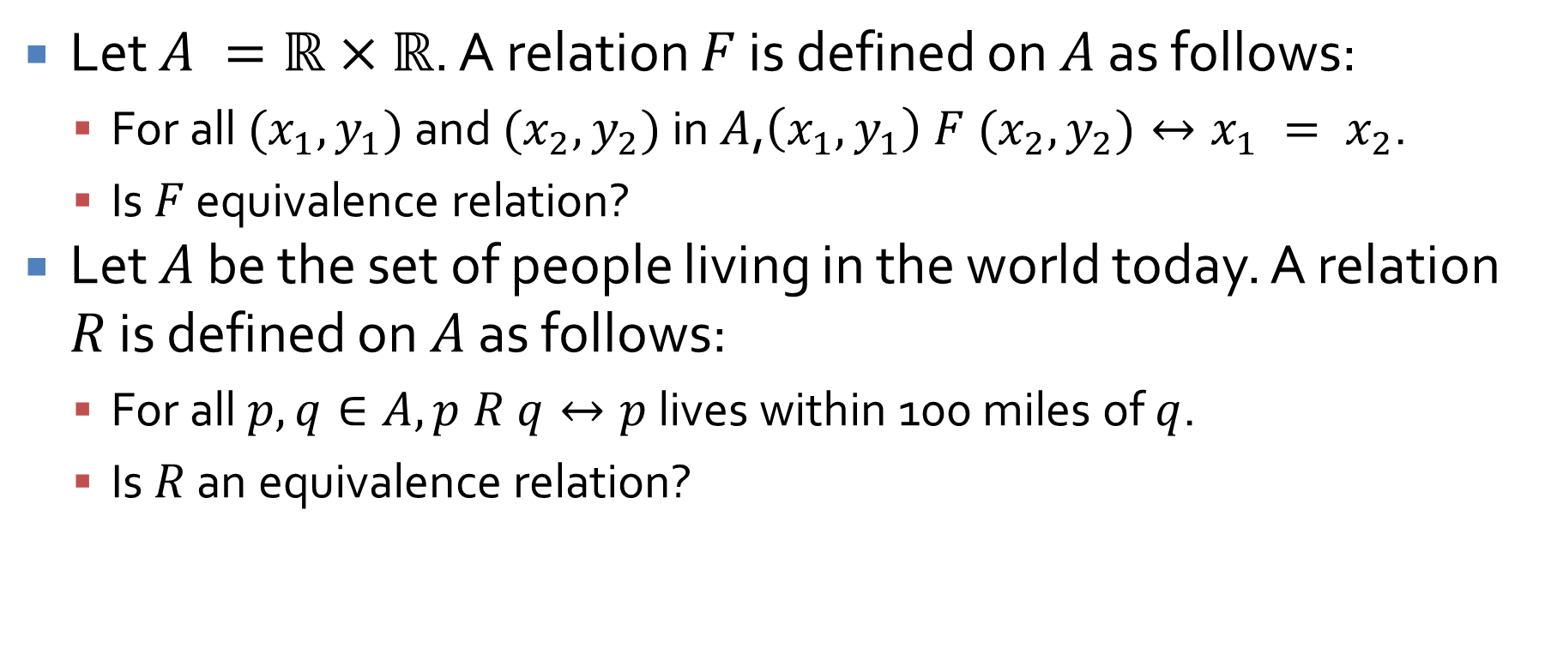
Equivalence relation practice
Let $A =ℝ×ℝ$. A relation $F$ is defined on $A$ as follows:
  For all $(x_{1}, y_{1})$ and $(x_{2}, y_{2})$ in $A$,$\left(x_{1}, y_{1}\right) F (x_{2}, y_{2})↔x_{1} = x_{2}$.
  Is $F$ equivalence relation?
Let $A$ be the set of people living in the world today. A relation $R$ is defined on $A$ as follows:
  For all $p, q∈A, p R q↔p$ lives within 100 miles of $q$.
  Is $R$ an equivalence relation?

Slide 6
Modular Arithmetic and Partial Orders
Three-sentence summary

Slide 7
Modular Arithmetic

Slide 8
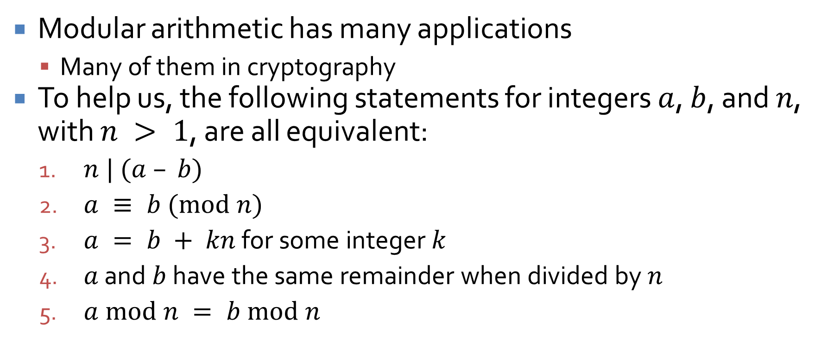
Modular arithmetic
Modular arithmetic has many applications
  Many of them in cryptography
To help us, the following statements for integers $a$, $b$, and $n$, with $n > 1$, are all equivalent:
  $n | (a – b)$
  $a ≡ b (mod n)$
  $a = b + kn$ for some integer $k$
  $a$ and $b$ have the same remainder when divided by $n$
  $a mod n = b mod n$

Slide 9
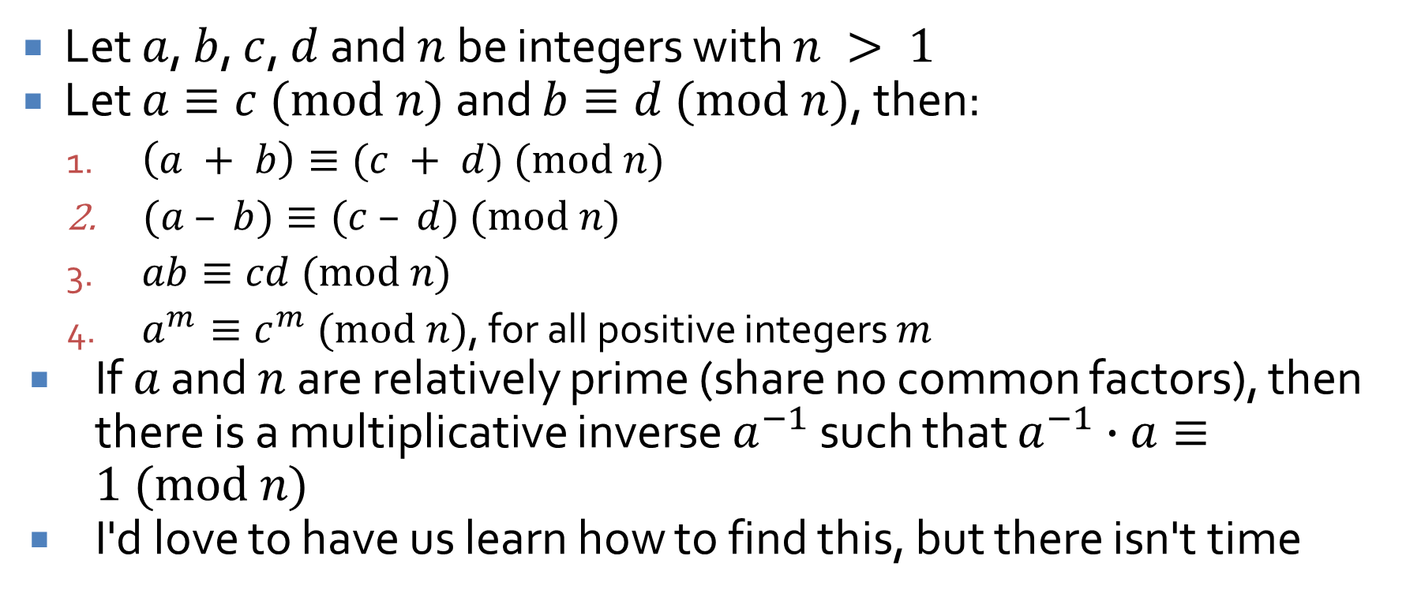
Rules of modular arithmetic
Let $a$, $b$, $c$, $d$ and $n$ be integers with $n > 1$
Let $a≡c (mod n)$ and $b≡d (mod n)$, then:
  $\left(a + b\right)≡(c + d) (mod n)$
  $(a – b)≡(c – d) (mod n)$
  $ab≡cd (mod n)$
  $a^{m}≡c^{m} (mod n)$, for all positive integers $m$
If $a$ and $n$ are relatively prime (share no common factors), then there is a multiplicative inverse $a^{−1}$ such that $a^{−1}∙a≡1 (mod n)$
I'd love to have us learn how to find this, but there isn't time

Slide 10
Partial Orders

Slide 11
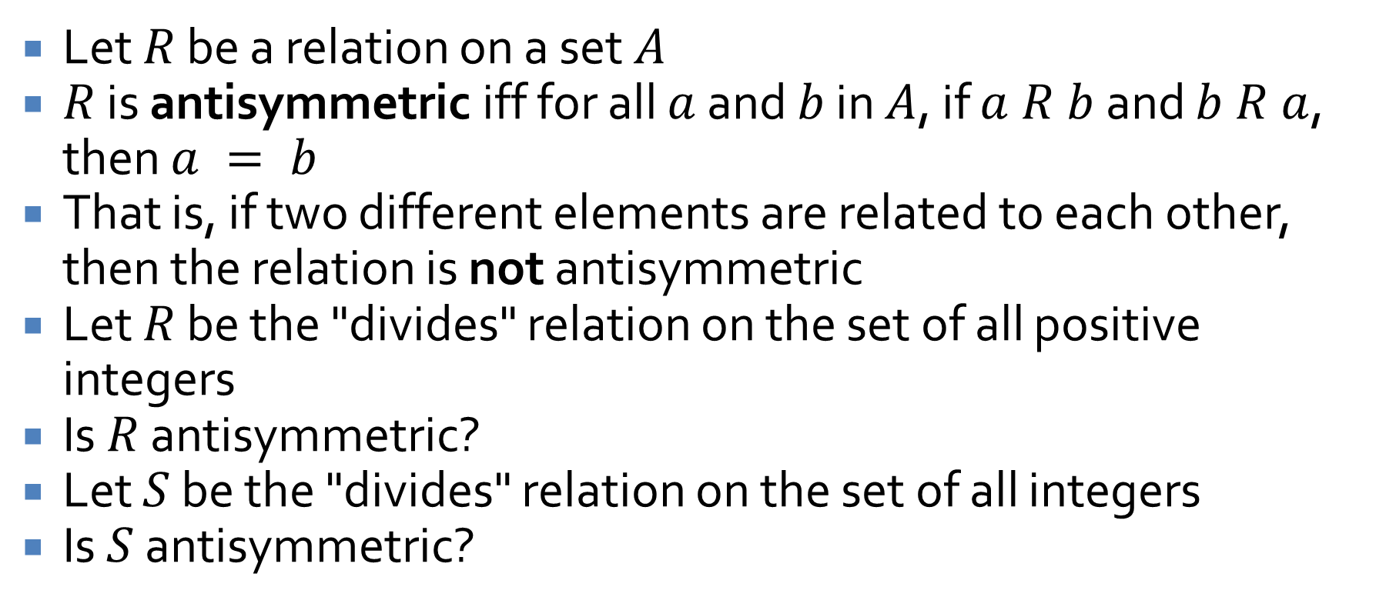
Antisymmetry
Let $R$ be a relation on a set $A$
$R$ is antisymmetric iff for all $a$ and $b$ in $A$, if $a R b$ and $b R a$, then $a = b$
That is, if two different elements are related to each other, then the relation is not antisymmetric
Let $R$ be the "divides" relation on the set of all positive integers
Is $R$ antisymmetric?
Let $S$ be the "divides" relation on the set of all integers
Is $S$ antisymmetric?

Slide 12
Partial orders
A relation that is reflexive, antisymmetric, and transitive is called a partial order
The subset relation is a partial order
  Show it's reflexive
  Show it's antisymmetric
  Show it's transitive
The less than or equal to relation is a partial order
  Show it's reflexive
  Show it's antisymmetric
  Show it's transitive

Slide 13
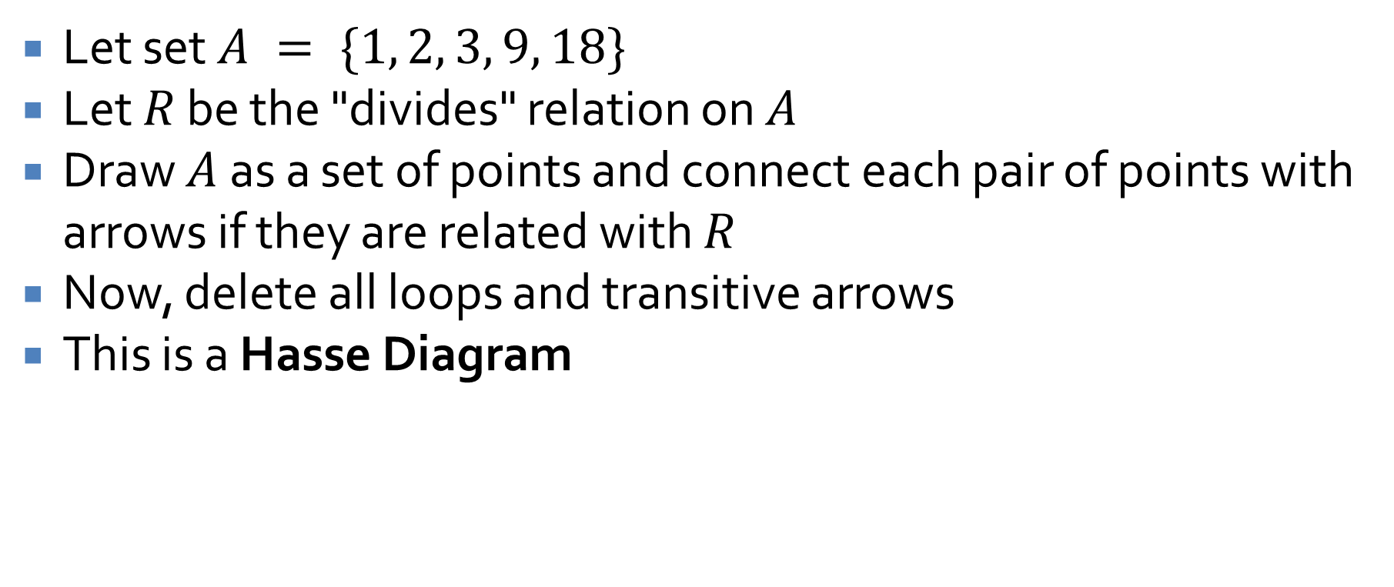
Hasse Diagrams
Let set $A = \{1, 2, 3, 9, 18\}$
Let $R$ be the "divides" relation on $A$
Draw $A$ as a set of points and connect each pair of points with arrows if they are related with $R$
Now, delete all loops and transitive arrows
This is a Hasse Diagram

Slide 14
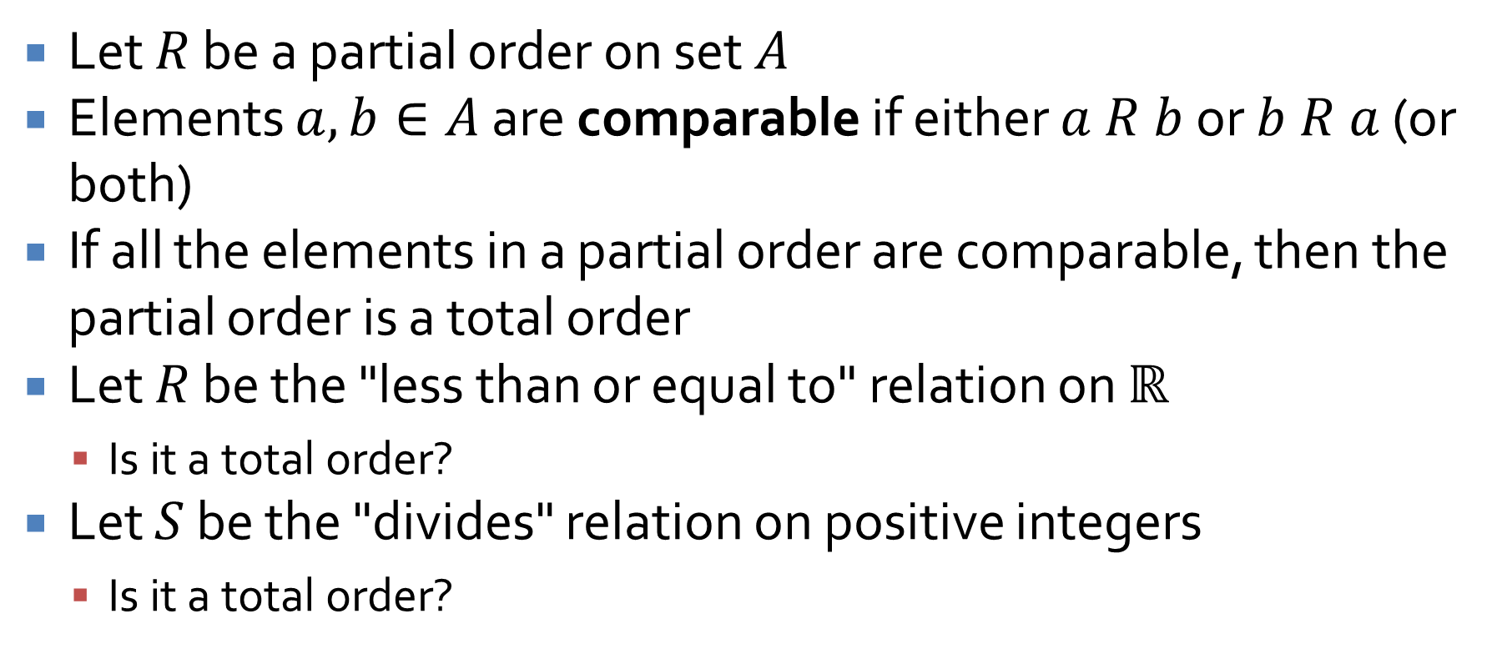
Total orders
Let $R$ be a partial order on set $A$
Elements $a,b∈A$ are comparable if either $a R b$ or $b R a$ (or both)
If all the elements in a partial order are comparable, then the partial order is a total order
Let $R$ be the "less than or equal to" relation on $ℝ$
  Is it a total order?
Let $S$ be the "divides" relation on positive integers
  Is it a total order?

Slide 15
Propositional Logic Review

Slide 16
Propositional logic
Statements
AND, OR, NOT, IMPLIES
Truth tables
Logical equivalence
De Morgan's laws
Tautologies and contradictions

Slide 17
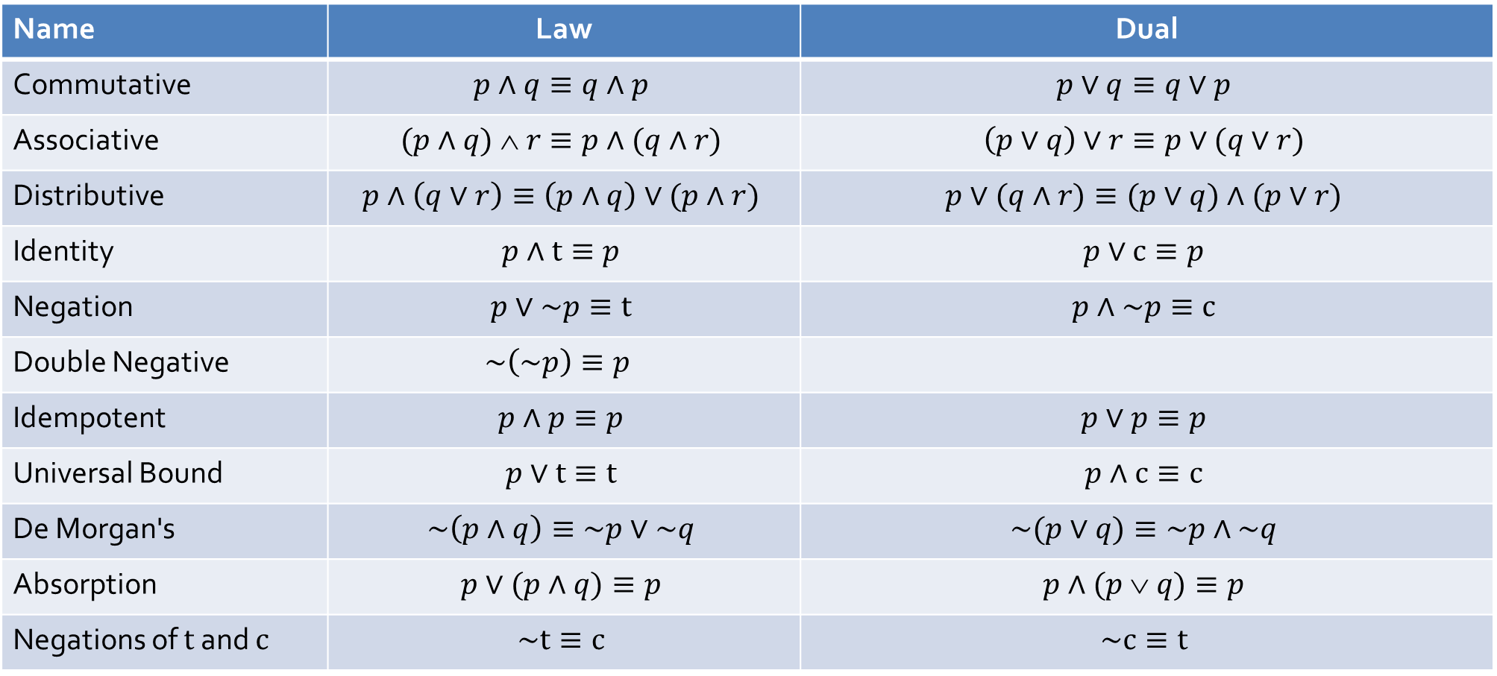
Laws of Boolean algebra
Name | Law | Dual
Commutative | $$p∧q≡q∧p$$ | $$p∨q≡q∨p$$
Associative | $$(p∧q)  r≡p∧(q∧r)$$ | $$\left(p∨q\right)∨r≡p∨(q∨r)$$
Distributive | $$p∧\left(q∨r\right)≡\left(p∧q\right)∨(p∧r)$$ | $$p∨(q∧r)≡(p∨q)∧(p∨r)$$
Identity | $$p∧t≡p$$ | $$p∨c≡p$$
Negation | $$p∨\sim p≡t$$ | $$p∧\sim p≡c$$
Double Negative | $$\sim \left(\sim p\right)≡p$$
Idempotent | $$p∧p≡p$$ | $$p∨p≡p$$
Universal Bound | $$p∨t≡t$$ | $$p∧c≡c$$
De Morgan's | $$\sim \left(p∧q\right)≡\sim p∨\sim q$$ | $$\sim (p∨q)≡\sim p∧\sim q$$
Absorption | $$p∨(p∧q)≡p$$ | $$p∧(p  q)≡p$$
Negations of $t$ and $c$ | $$\sim t≡c$$ | $$\sim c≡t$$

Slide 18
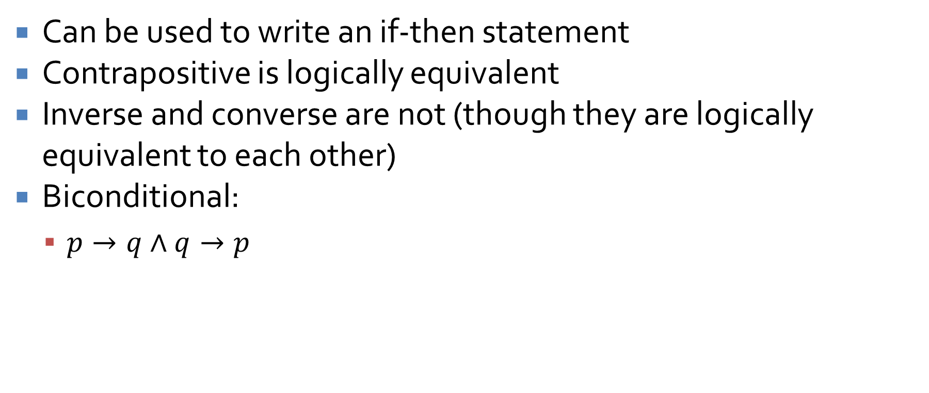
Implications
Can be used to write an if-then statement
Contrapositive is logically equivalent
Inverse and converse are not (though they are logically equivalent to each other)
Biconditional:
  $p→q∧q→p$

Slide 19
Predicate Logic Review

Slide 20
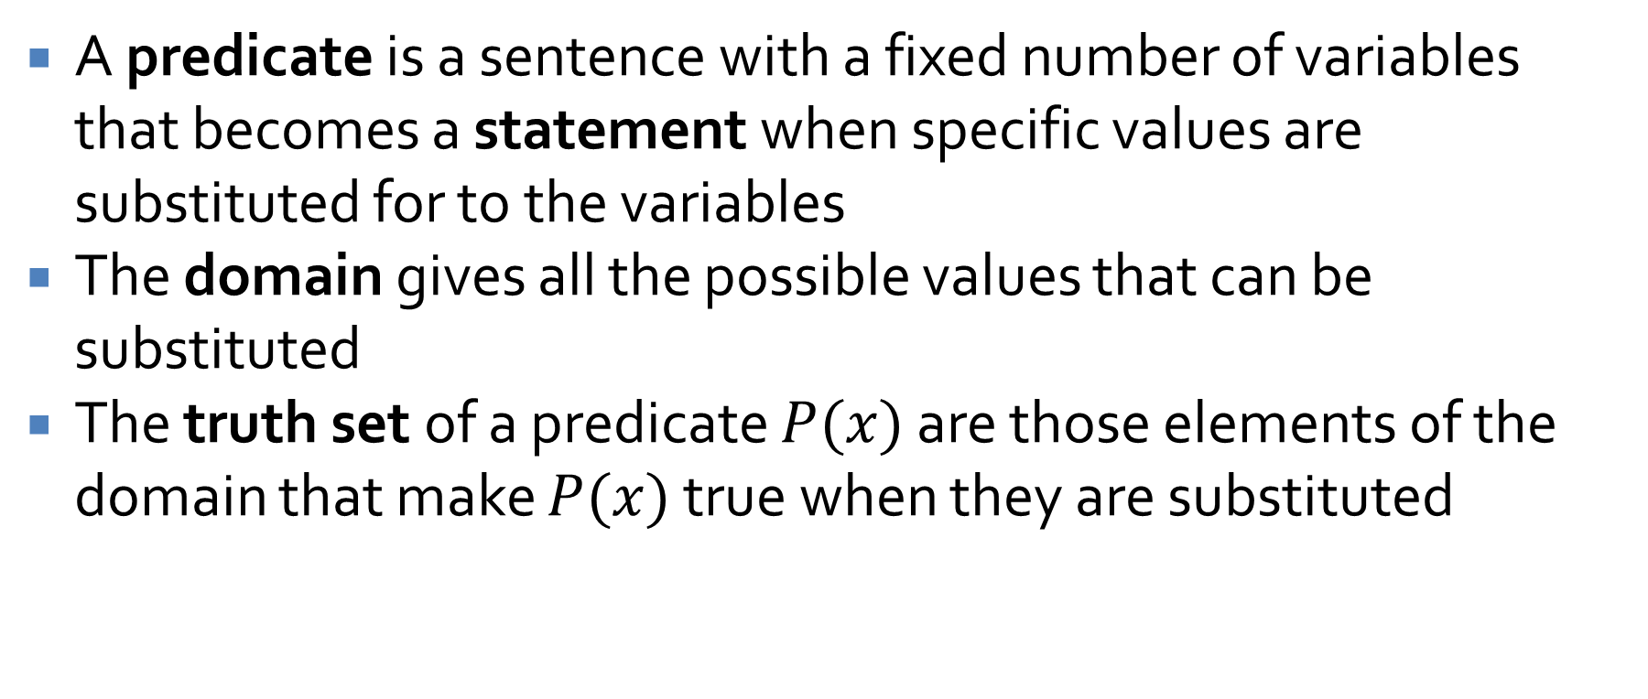
Predicates
A predicate is a sentence with a fixed number of variables that becomes a statement when specific values are substituted for to the variables
The domain gives all the possible values that can be substituted
The truth set of a predicate $P(x)$ are those elements of the domain that make $P(x)$ true when they are substituted

Slide 21
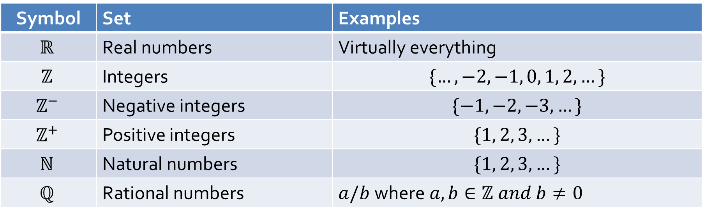
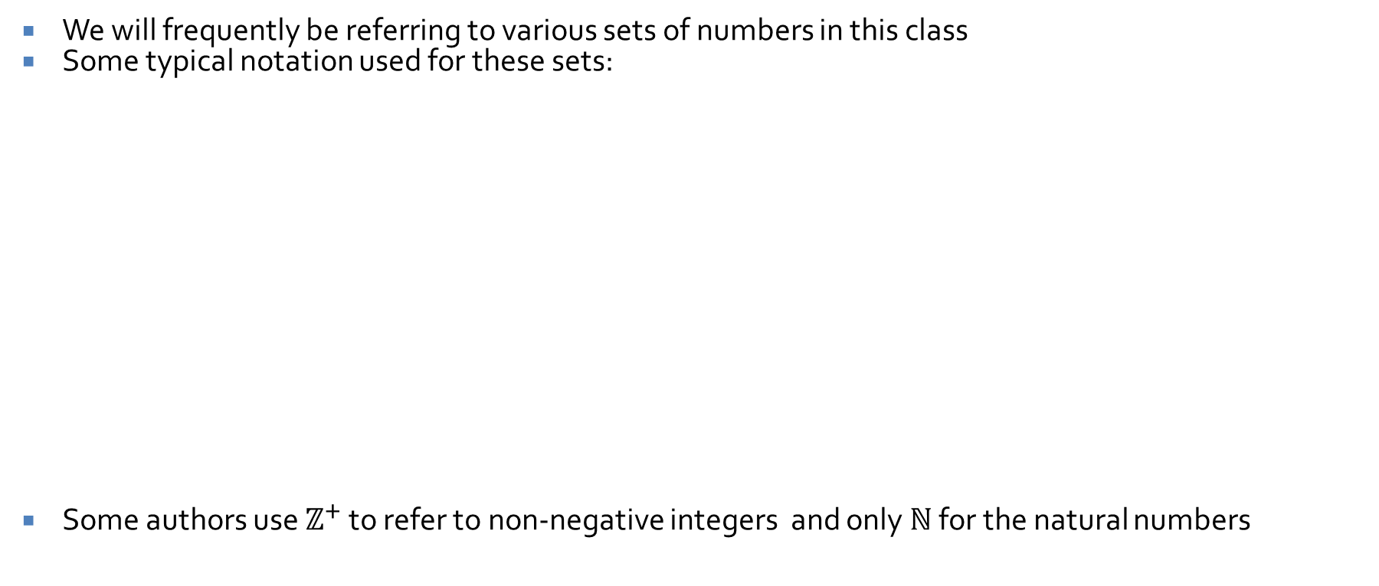
Sets
We will frequently be referring to various sets of numbers in this class
Some typical notation used for these sets:
Some authors use $ℤ^{+}$ to refer to non-negative integers and only $ℕ$ for the natural numbers
Symbol | Set | Examples
$$ℝ$$ | Real numbers | Virtually everything
$$ℤ$$ | Integers | $$\{…, −2, −1, 0, 1, 2,…\}$$
$$ℤ^{−}$$ | Negative integers | $$\{−1, −2, −3, …\}$$
$$ℤ^{+}$$ | Positive integers | $$\{1, 2, 3, …\}$$
$$ℕ$$ | Natural numbers | $$\{1, 2, 3, …\}$$
$$ℚ$$ | Rational numbers | $a/b$where$a,b∈ℤ and b≠0$

Slide 22
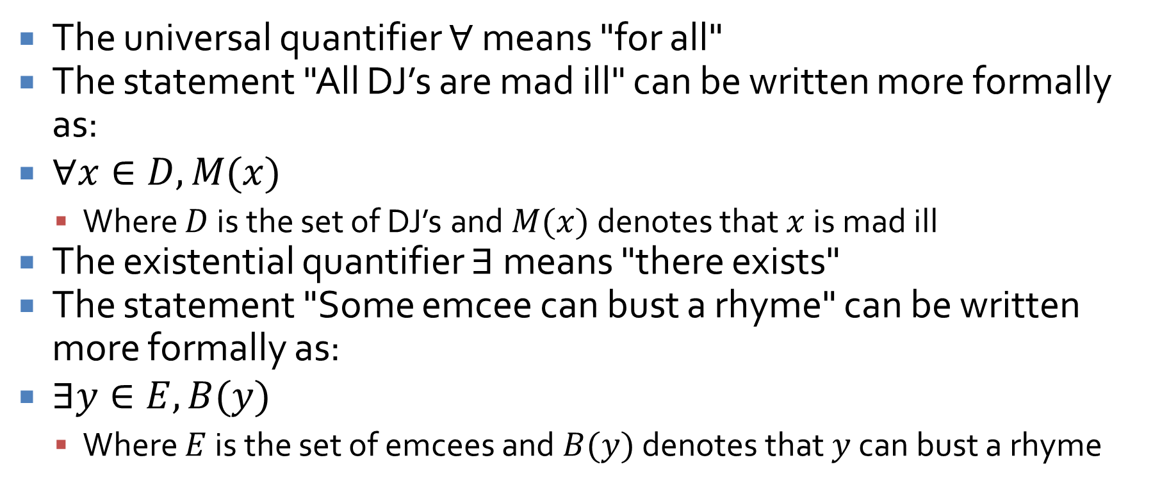
Quantifiers
The universal quantifier $∀$ means "for all"
The statement "All DJ’s are mad ill" can be written more formally as:
$∀x∈D, M(x)$
  Where $D$ is the set of DJ’s and $M(x)$ denotes that $x$ is mad ill
The existential quantifier $∃$ means "there exists"
The statement "Some emcee can bust a rhyme" can be written more formally as:
$∃y∈E, B(y)$
  Where $E$ is the set of emcees and $B(y)$ denotes that $y$ can bust a rhyme

Slide 23
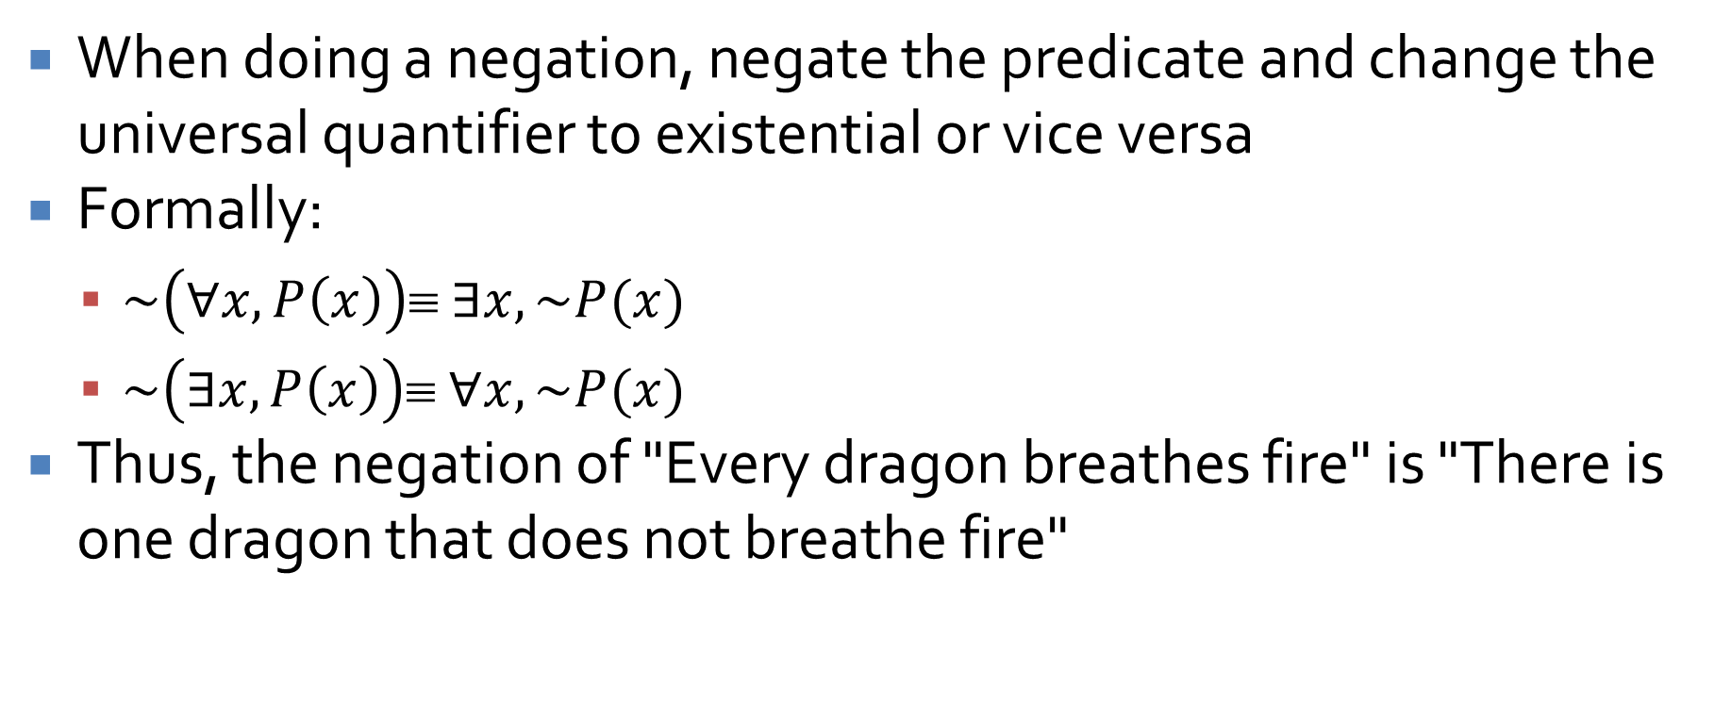
Negating quantified statements
When doing a negation, negate the predicate and change the universal quantifier to existential or vice versa
Formally:
  $\sim \left(∀x, P\left(x\right)\right)≡ ∃x, \sim P(x)$
  $\sim \left(∃x, P\left(x\right)\right)≡ ∀x, \sim P(x)$
Thus, the negation of "Every dragon breathes fire" is "There is one dragon that does not breathe fire"

Slide 24
Vacuously true
Any statement with a universal quantifier whose domain is the empty set is vacuously true
When we talk about "all things" and there's nothing there, we can say anything we want
"All mythological creatures are real."
Every single one of the (of which there are none) is real

Slide 25
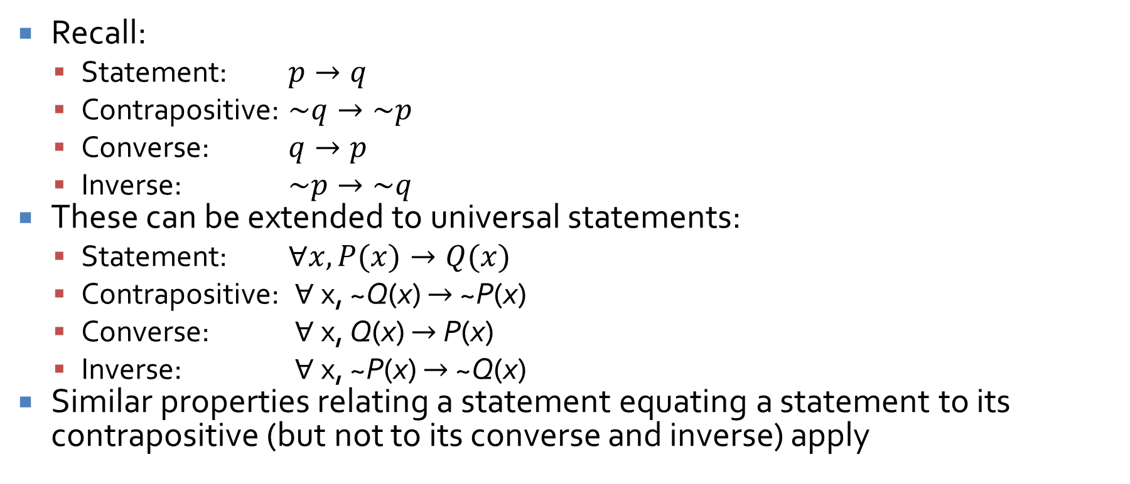
Conditionals
Recall:
  Statement: $p→q$
  Contrapositive: $\sim q→\sim p$
  Converse: $q→p$
  Inverse: $\sim p→\sim q$
These can be extended to universal statements:
  Statement: $∀x, P(x)→Q(x)$
  Contrapositive: $∀$x, ~Q(x) $→$ ~P(x)
  Converse: $∀$x, Q(x) $→$ P(x)
  Inverse: $∀$x, ~P(x) $→$ ~Q(x)
Similar properties relating a statement equating a statement to its contrapositive (but not to its converse and inverse) apply

Slide 26
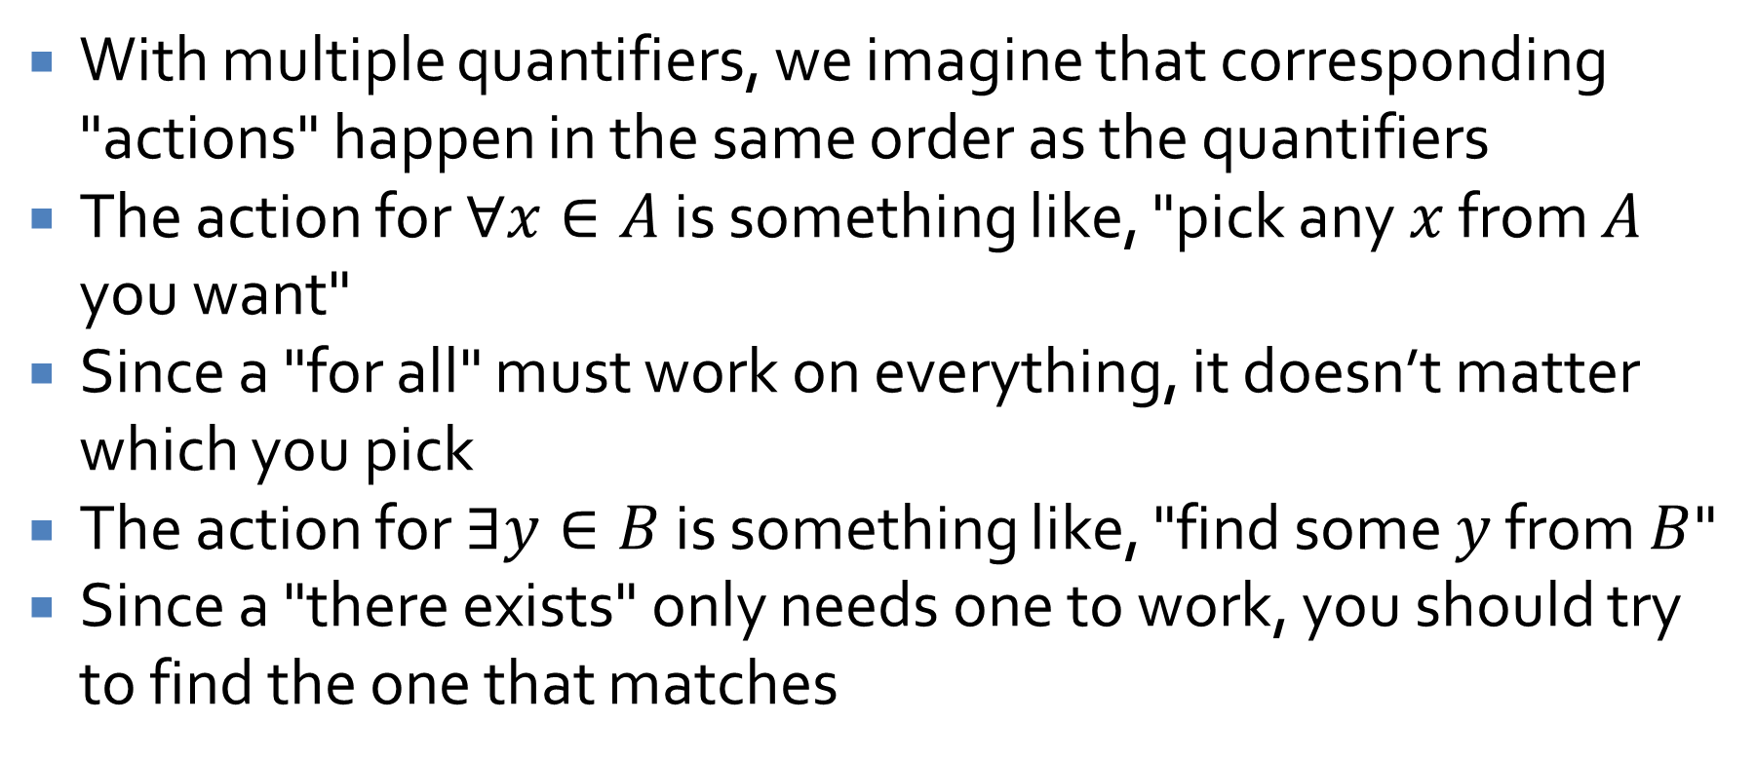
Multiple quantifiers
With multiple quantifiers, we imagine that corresponding "actions" happen in the same order as the quantifiers
The action for $∀x∈A$ is something like, "pick any $x$ from $A$ you want"
Since a "for all" must work on everything, it doesn’t matter which you pick
The action for $∃y∈B$ is something like, "find some $y$ from $B$"
Since a "there exists" only needs one to work, you should try to find the one that matches

Slide 27
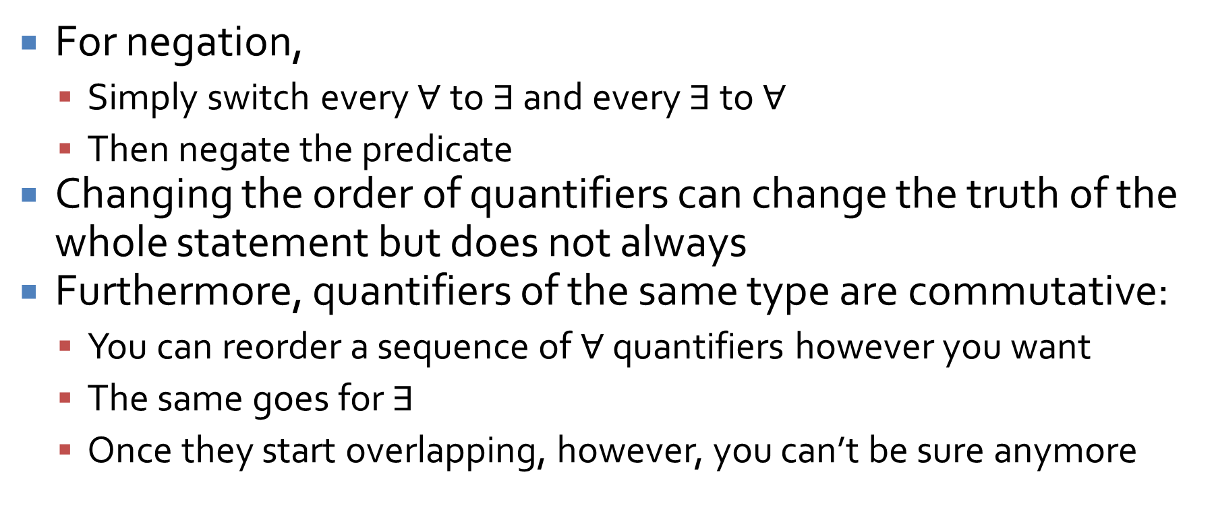
Negating or changing multiple quantifiers
For negation,
  Simply switch every $∀$ to $∃$ and every $∃$ to $∀$
  Then negate the predicate
Changing the order of quantifiers can change the truth of the whole statement but does not always
Furthermore, quantifiers of the same type are commutative:
  You can reorder a sequence of $∀$ quantifiers however you want
  The same goes for $∃$
  Once they start overlapping, however, you can’t be sure anymore

Slide 28
Proofs Review

Slide 29
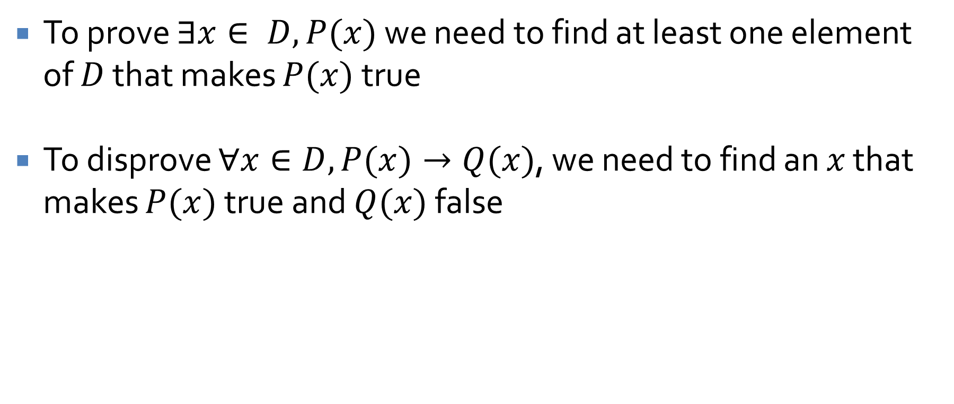
Proving existential statements and disproving universal ones
To prove $∃x∈ D, P(x)$ we need to find at least one element of $D$ that makes $P(x)$ true
To disprove $∀x∈D, P(x)→Q(x)$, we need to find an $x$ that makes $P(x)$true and $Q(x)$ false

Slide 30
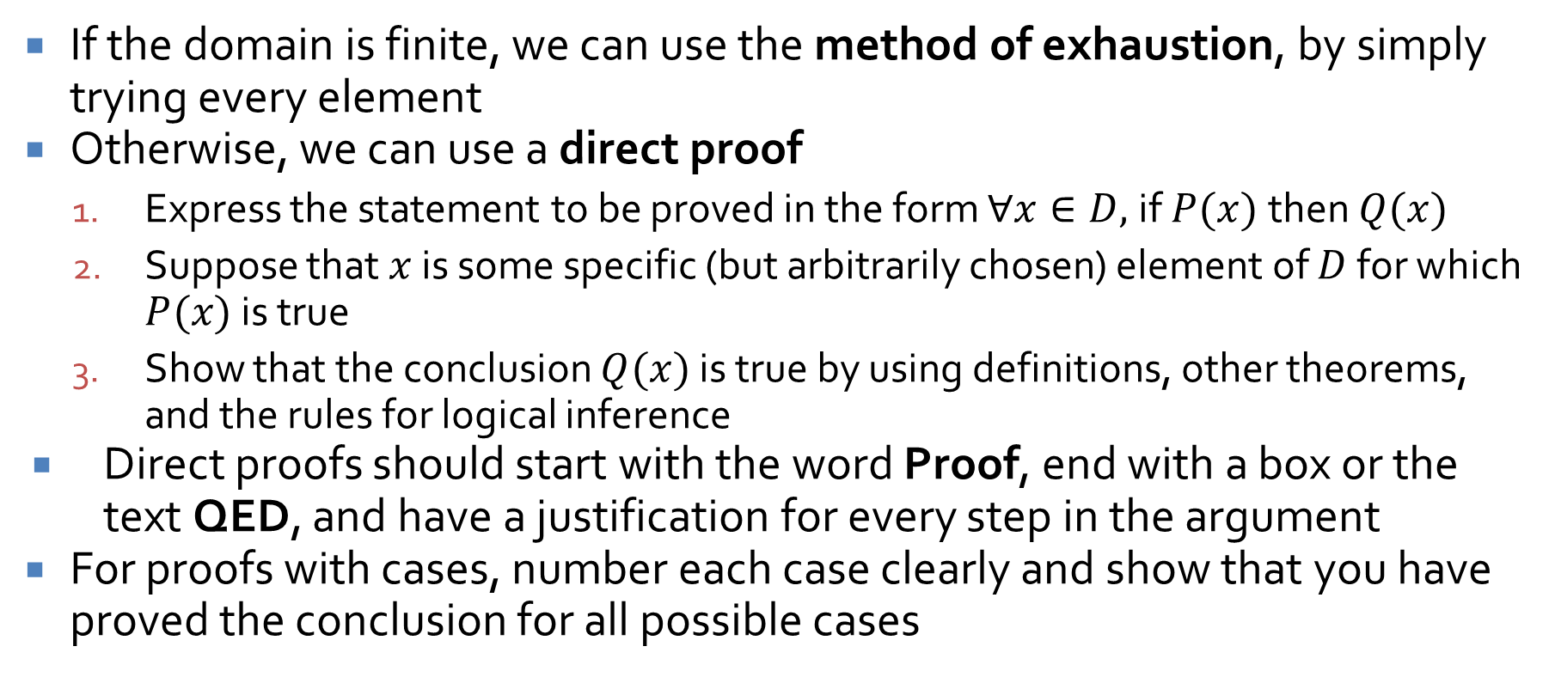
Proving universal statements
If the domain is finite, we can use the method of exhaustion, by simply trying every element
Otherwise, we can use a direct proof
  Express the statement to be proved in the form $∀x∈D,$if $P(x)$then $Q(x)$
  Suppose that $x$ is some specific (but arbitrarily chosen) element of $D$ for which $P(x)$ is true
  Show that the conclusion $Q(x)$ is true by using definitions, other theorems, and the rules for logical inference
Direct proofs should start with the word Proof, end with a box or the text QED, and have a justification for every step in the argument
For proofs with cases, number each case clearly and show that you have proved the conclusion for all possible cases

Slide 31
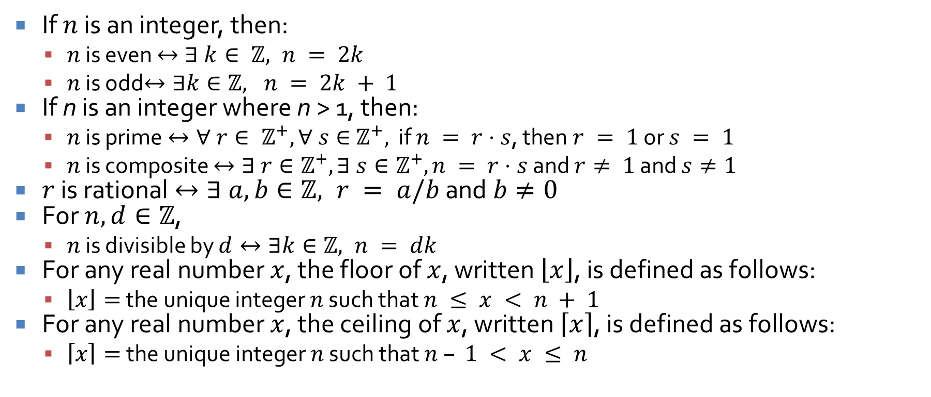
Definitions
If $n$ is an integer, then:
  $n$ is even $↔∃ k∈ ℤ, n = 2k$
  $n$ is odd$↔∃k∈ℤ, n = 2k + 1$
If n is an integer where n > 1, then:
  $n$ is prime $↔∀ r∈ ℤ^{+}, ∀ s∈{ ℤ}^{+},$ if $n = r⋅s$, then $r = 1$ or $s = 1$
  $n$ is composite $↔∃ r∈ℤ^{+},∃ s∈ℤ^{+}, n = r⋅s$ and $r≠ 1$ and $s≠1$
$r$ is rational $↔∃ a, b∈ℤ, r = a/b$ and $b≠0$
For $n, d∈ℤ$,
  $n$ is divisible by $d↔∃k∈ℤ, n = dk$
For any real number $x$, the floor of $x$, written $\left\lfloor x\right\rfloor$, is defined as follows:
  $\left\lfloor x\right\rfloor =$ the unique integer $n$ such that $n ≤ x < n + 1$
For any real number $x$, the ceiling of $x$, written $\left\lceil x\right\rceil$, is defined as follows:
  $\left\lceil x\right\rceil =$the unique integer $n$ such that $n – 1 < x ≤ n$

Slide 32
Indirect Proofs

Slide 33
Proof by contradiction
In a proof by contradiction, you begin by assuming the negation of the conclusion
Then, you show that doing so leads to a logical impossibility
Thus, the assumption must be false and the conclusion true

Slide 34
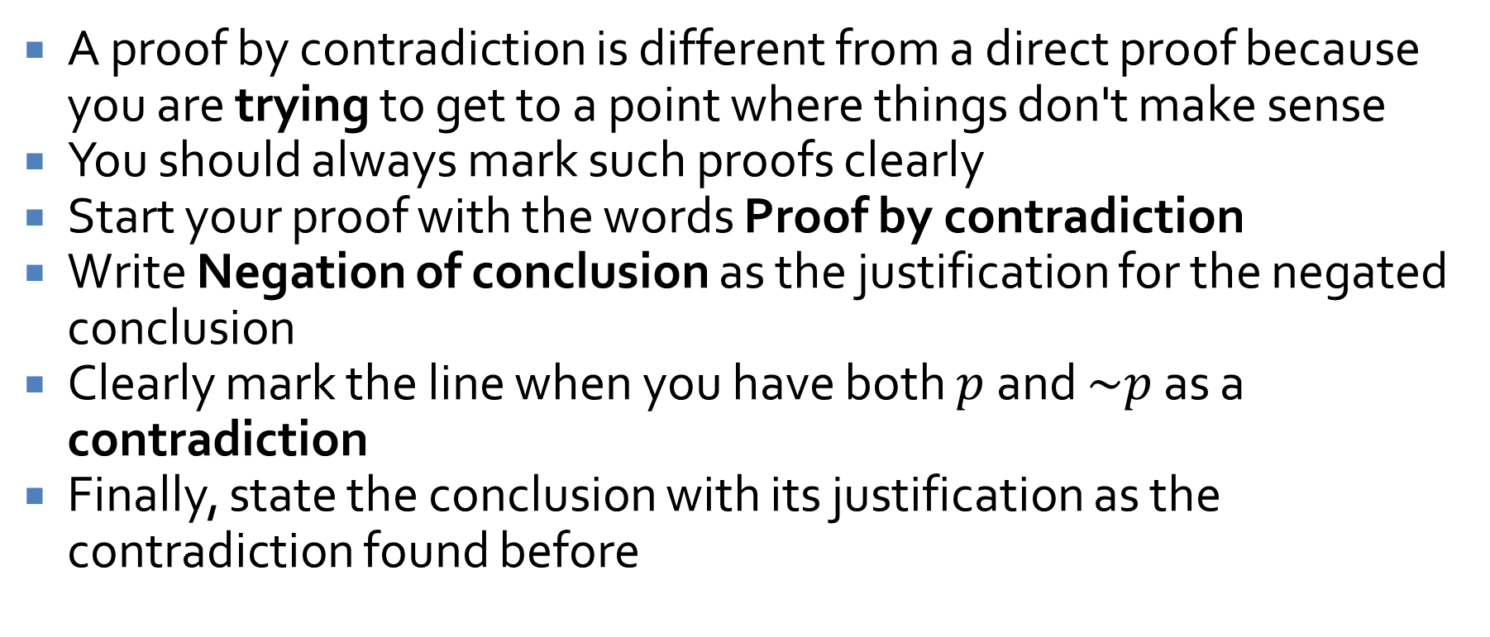
Contradiction formatting
A proof by contradiction is different from a direct proof because you are trying to get to a point where things don't make sense
You should always mark such proofs clearly
Start your proof with the words Proof by contradiction
Write Negation of conclusion as the justification for the negated conclusion
Clearly mark the line when you have both $p$ and $\sim p$ as a contradiction
Finally, state the conclusion with its justification as the contradiction found before

Slide 35
Set Theory

Slide 36
Set theory basics
Defining finite and infinite sets
Definitions of:
  Subset
  Proper subset
  Set equality
Set operations:
  Union
  Intersection
  Difference
  Complement
The empty set
Partitions
Cartesian product

Slide 37
Set theory proofs
Proving a subset relation
  Element method: Assume an element is in one set and show that it must be in the other set
  Algebraic laws of set theory: Using the algebraic laws of set theory (given on the next slide), we can show that two sets are equal
Disproving a universal statement requires a counterexample with specific sets

Slide 38
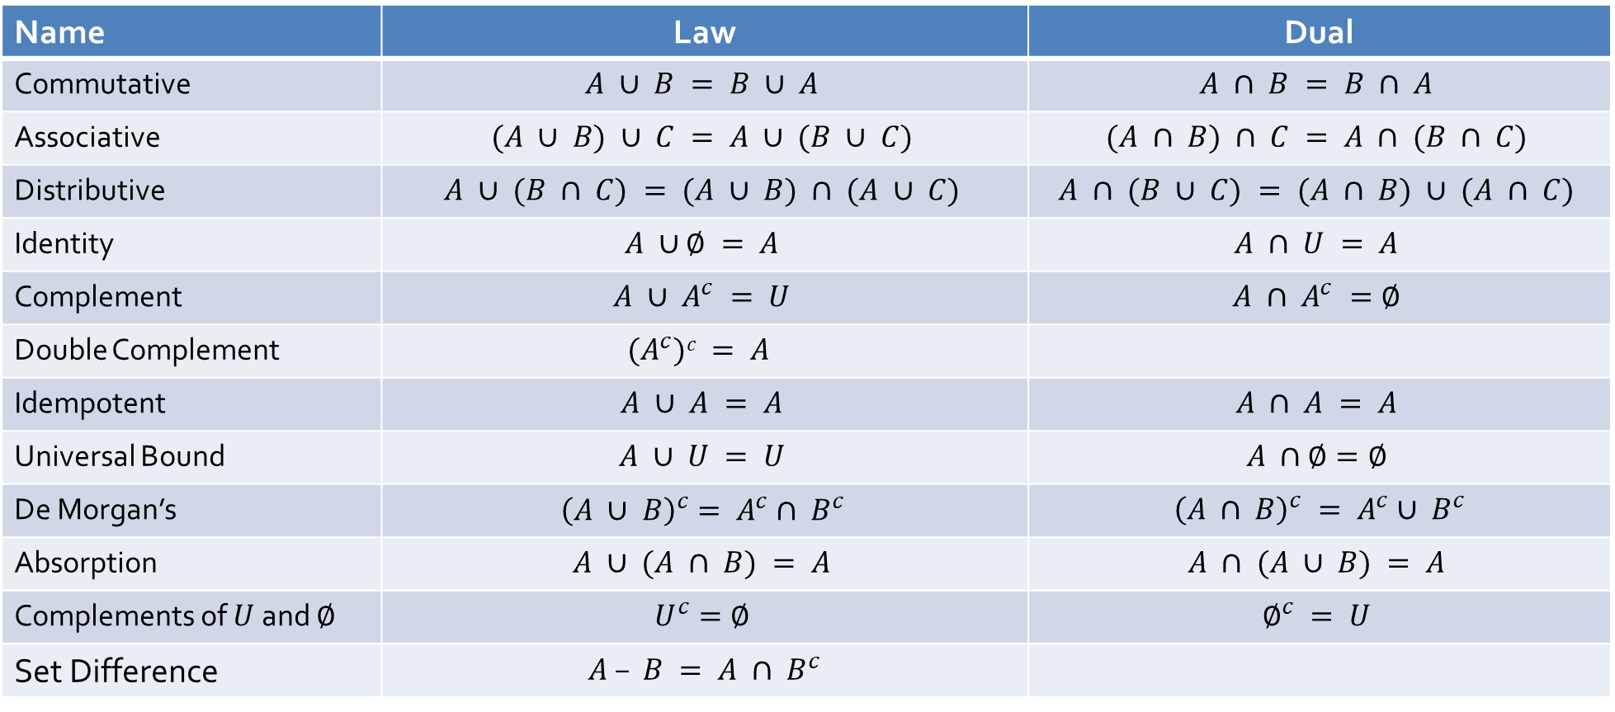
Laws of set theory
Name | Law | Dual
Commutative | $$A ∪ B = B ∪ A$$ | $$A ∩ B = B ∩ A$$
Associative | $$(A ∪ B) ∪ C = A ∪ (B ∪ C)$$ | $$(A ∩ B) ∩ C = A ∩ (B ∩ C)$$
Distributive | $$A ∪ (B ∩ C) = (A ∪ B) ∩ (A ∪ C)$$ | $$A ∩ (B ∪ C) = (A ∩ B) ∪ (A ∩ C)$$
Identity | $$A ∪∅ = A$$ | $$A ∩ U = A$$
Complement | $$A ∪ A^{c} = U$$ | $$A ∩ A^{c} =∅$$
Double Complement | $$(A^{c})c = A$$
Idempotent | $$A ∪ A = A$$ | $$A ∩ A = A$$
Universal Bound | $$A ∪ U = U$$ | $$A ∩∅=∅$$
De Morgan’s | $${\left(A ∪ B\right)}^{c}= A^{c}∩ B^{c}$$ | ${\left(A ∩ B\right)}^{c} = A^{c}∪ B^{c}$
Absorption | $$A ∪ (A ∩ B) = A$$ | $$A ∩ (A ∪ B) = A$$
Complements of $U$ and $∅$ | $$U^{c}=∅$$ | $$∅^{c} = U$$
Set Difference | $A – B = A ∩ B^{c}$

Slide 39
Russell's paradox
It is possible to give a description for a set which describes a set that does not actually exist
For a well-defined set, we should be able to say whether or not a given element is or is not a member
If we can find an element that must be in a specific set and must not be in a specific set, that set is not well defined
Watch out for definitions that are logically inconsistent!

Slide 40
Functions
One-to-one (injective) functions
Onto (surjective) functions
If a function is both one-to-one and onto, we call it bijective

Slide 41
Cardinality
Cardinality is the number of things in a set
  It is reflexive, symmetric, and transitive
Two sets have the same cardinality if a bijective function maps every element in one to an element in the other
Any set with the same cardinality as positive integers is called countably infinite

Slide 42
Relations

Slide 43
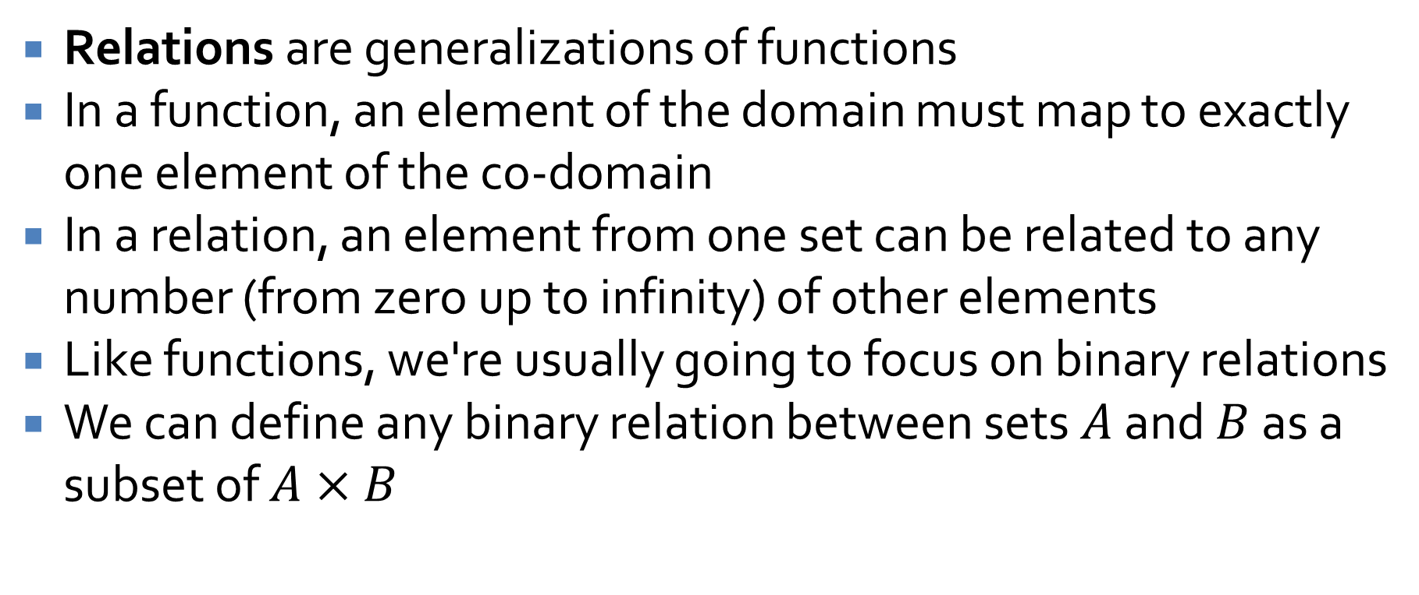
Relations
Relations are generalizations of functions
In a function, an element of the domain must map to exactly one element of the co-domain
In a relation, an element from one set can be related to any number (from zero up to infinity) of other elements
Like functions, we're usually going to focus on binary relations
We can define any binary relation between sets $A$ and $B$ as a subset of $A×B$

Slide 44
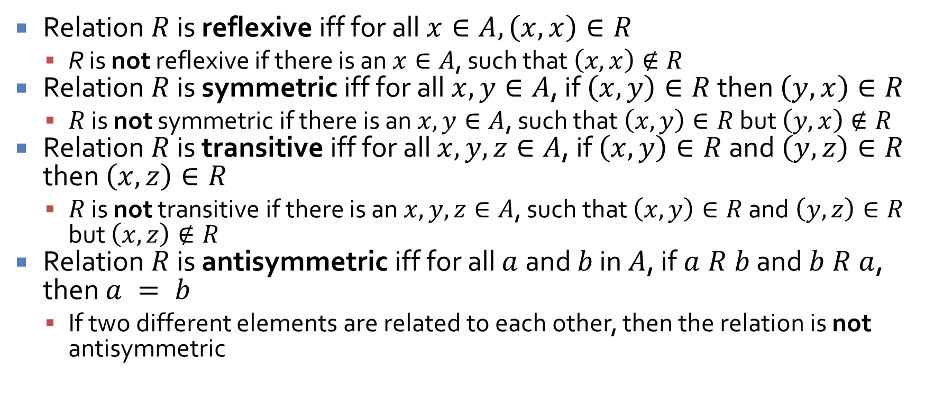
Properties
Relation $R$ is reflexive iff for all $x∈A, \left(x, x\right)∈R$
  R is not reflexive if there is an $x∈A$, such that $\left(x, x\right)∉R$
Relation $R$ is symmetric iff for all $x, y∈A$, if $\left(x, y\right)∈R$ then $\left(y, x\right)∈R$
  $R$ is not symmetric if there is an $x, y∈A$, such that $\left(x, y\right)∈R$ but $\left(y, x\right)∉R$
Relation $R$ is transitive iff for all $x, y, z∈A$, if $\left(x, y\right)∈R$ and $\left(y, z\right)∈R$ then $\left(x, z\right)∈R$
  $R$ is not transitive if there is an $x, y, z∈A$, such that $\left(x, y\right)∈R$ and $\left(y, z\right)∈R$ but $\left(x, z\right)∉R$
Relation $R$ is antisymmetric iff for all $a$ and $b$ in $A$, if $a R b$ and $b R a$, then $a = b$
  If two different elements are related to each other, then the relation is not antisymmetric

Slide 45
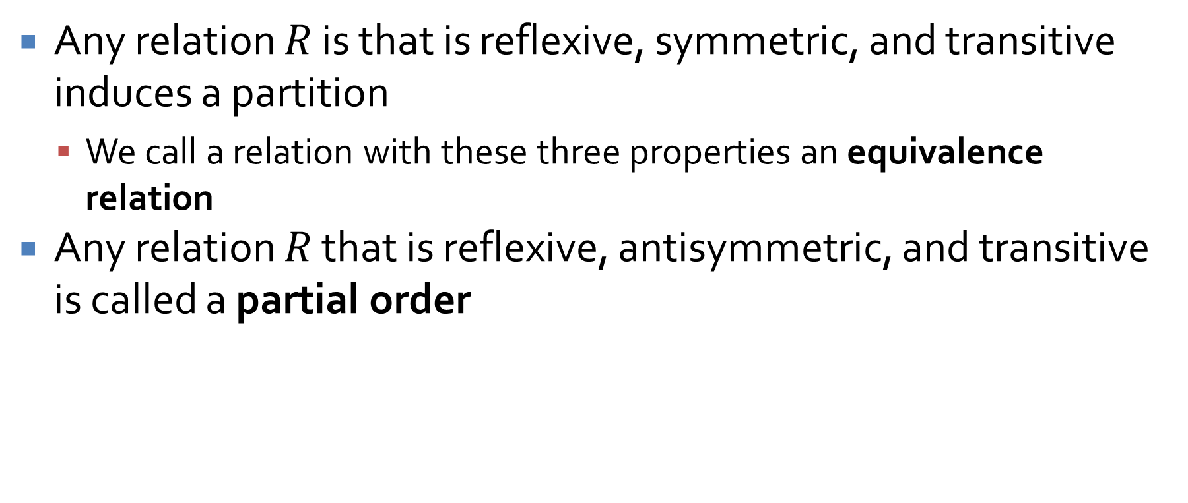
Kinds of relations
Any relation $R$ is that is reflexive, symmetric, and transitive induces a partition
  We call a relation with these three properties an equivalence relation
Any relation $R$ that is reflexive, antisymmetric, and transitive is called a partial order

Slide 46
Ticket Out the Door

Slide 47
Upcoming

Slide 48
Next time…
No class on Monday

Slide 49
Reminders
Finish Assignment 4
Exam 2 next Wednesday!
Office hours cancelled today
Read 9.1 and 9.2 for next Friday
  Write a three-sentence summary

